Slide 1
Introduction to your study
Ing. Katerina Mlejnkova

Slide 2

FBE website for degree students: https://pef.mendelu.cz/en/?psn=0

Slide 3
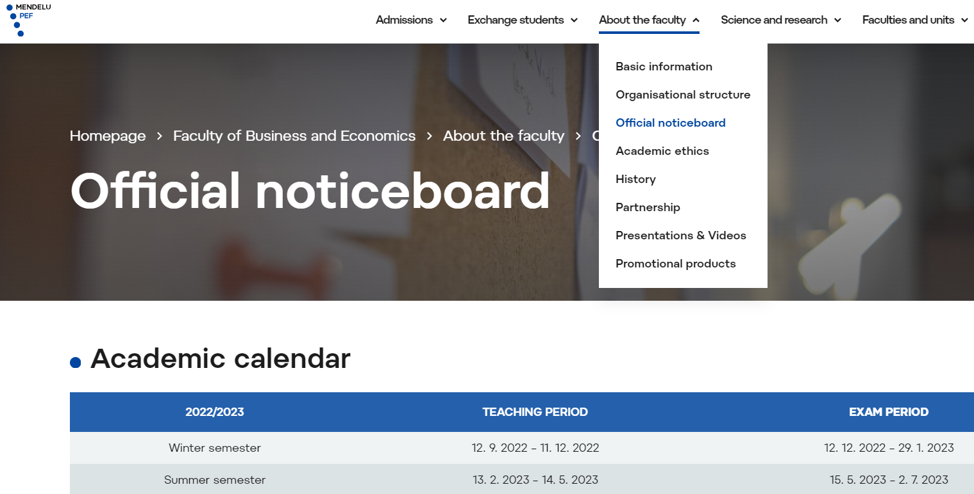
Academic regulations
Act no. 111/1998 on Higher Education Institutions
Study and Examination Regulations of MENDELU
Dean´s Regulations and Directives
Disciplinary Rules
Code of Conduct
https://pef.mendelu.cz/en/faculty-of-business-and-economics/about-the-faculty/official-noticeboard/?psn=54.54545211791992
Notes:
Student is obliged to follow law and other regulations, not-knowing is not an excuse = Ignorance of the law is no excuse
https://pef.mendelu.cz/en/faculty-of-business-and-economics/about-the-faculty/official-noticeboard/?psn=54.54545211791992

Slide 4
Credit system
Total number of credits
Bachelor study programme: 180 ECTS
(standard time: 3 years)
Master study programme: 120 ECTS
(standard time: 2 years)
Enrolment for a subsequent semester
1st semester – 12 ECTS
2 following semesters – 40 ECTS
The maximum study duration: double the standard lenght (6 Bc and 4 Ing)

Slide 5
Course information
If you fail, you can repeat the exam twice.
If you don´t complete the course in the given semester, you must re-enroll.
For repeat students, the course may be taught through consultations.
You must be enrolled for at least 1 course in each semester.
You must not be enrolled twice without the course completion (032_Z: Request to cancel the course(s) from the enrolment).
Course requirements are given by the course supervisor.
Notes:
Student cannot take some course for the third time, you must submit a request to cancel the enrolment

Slide 6

Complete required courses according to your study plan
Achieve the minimum number of credits
Submit your thesis
Pass the final state exam
(2 attempts)
How to gradute
Notes:
No matter how many credits you achieve, you need to complete the study plan.

Slide 7
Interruption of studies
Ex officio
- if you are behind with payment of the tuition fee
- if you complete your study plan and do not take the final state exam
Request
005_Z: Request for an interruption of studies
- not in the first semester
- you must fulfil the conditions for enrolment into the next semester
- at the beginning of the semester
→ we inform the Foreign police → visa issues
Notes:
Ex officio: Payment deadline is in August and January, the interuption is always for the whole semester! -> we inform the Foreign police -> troubles with visa
Request: student needs to return to the country, etc, vice-dean must approval the request (individual).
Maximum

Slide 8
Interruption of studies
The minimum = 1 semester
The total study interruption duration may not be longer than a half of the standard study duration.
You can interrupt your study repeatedly.
If your study is interrupted, you are not a student.
We have to inform the foreign police immediately.

Slide 9
Obligations and recommendation
Registration and courses enrollment
Inform the study department of any change in your personal information
Come to the study department upon request (within 7 days from delivery of this request)
Check for e-mail delivered to your University e-mail address (at least once in 7 days) (username@mendelu.cz)
Use the Contact Centre in the UIS
Check your study plan progress (Student´s Portal) and Study Financing
Respect office hours
Mobile application My MENDELU

Slide 10
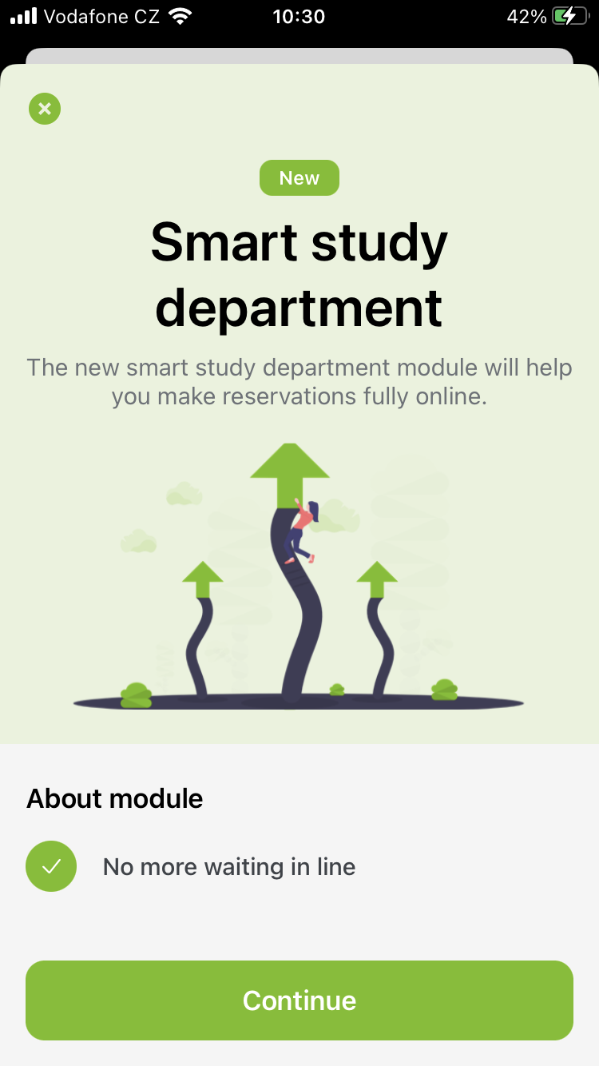
Office hours
Monday 10:00 – 11:30 reservation only!
Wednesday 10:00 – 11:30 & 13:00 – 14:00
Friday 8:30 – 11:30 reservation only!
Outside office hours: e-mails only
Reservation via My MENDELU app
https://my.mendelu.cz/

Slide 11

Sport activities
http://csa.mendelu.cz/en/
- 2 sports for free (per degree)
there is a fee of 420 CZK for every extra sport
(payments to CSA office)
- 1 ECTS credit for sport (per degree)
Students are responsible for cancellation of sports they do not want to continue in, otherwise they will be charged as if they attended. Such changes has to be made by date provided by CSA MENDELU.

Slide 12

Excuse notes
If you are not able to join class because of illness/doctor‘s visit, you are obliged to submit doctor‘s confirmation to Study Department.

Slide 13
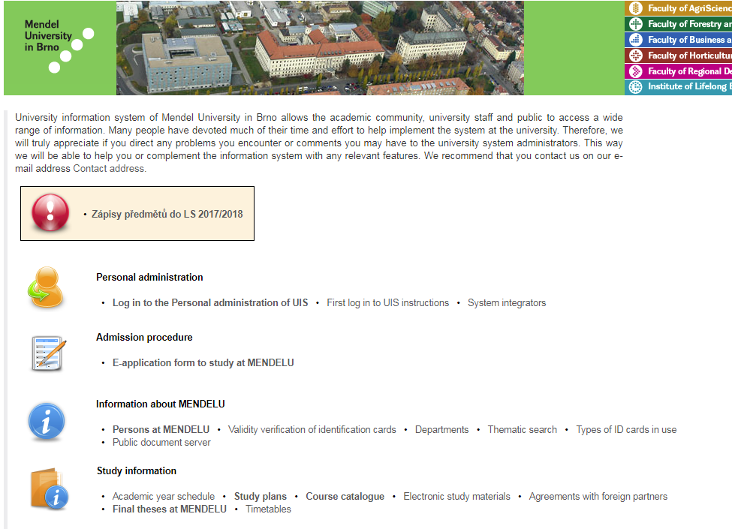
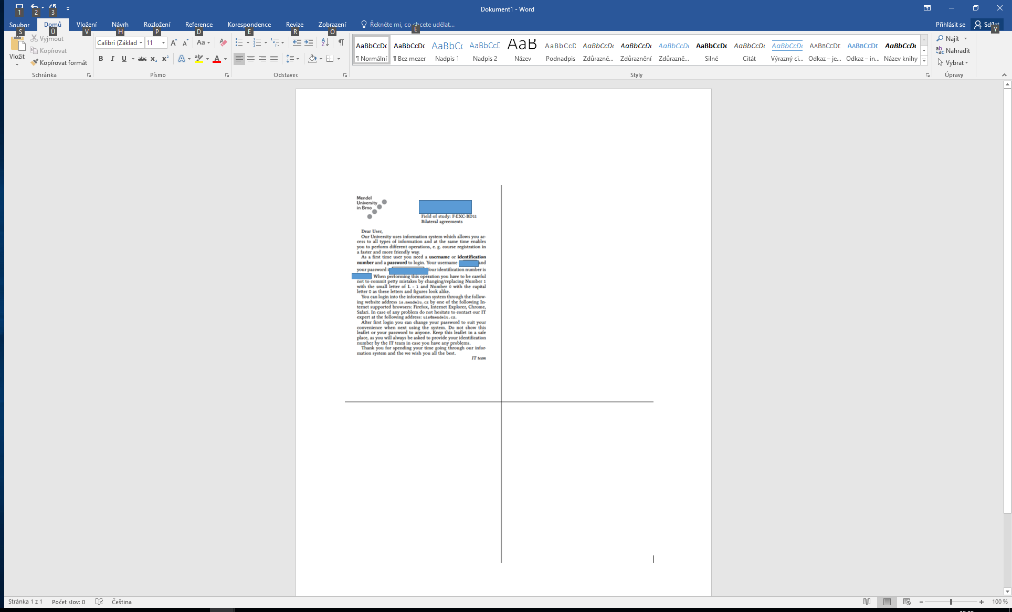
UIS - University Information System
www.is.mendelu.cz/en

Slide 14
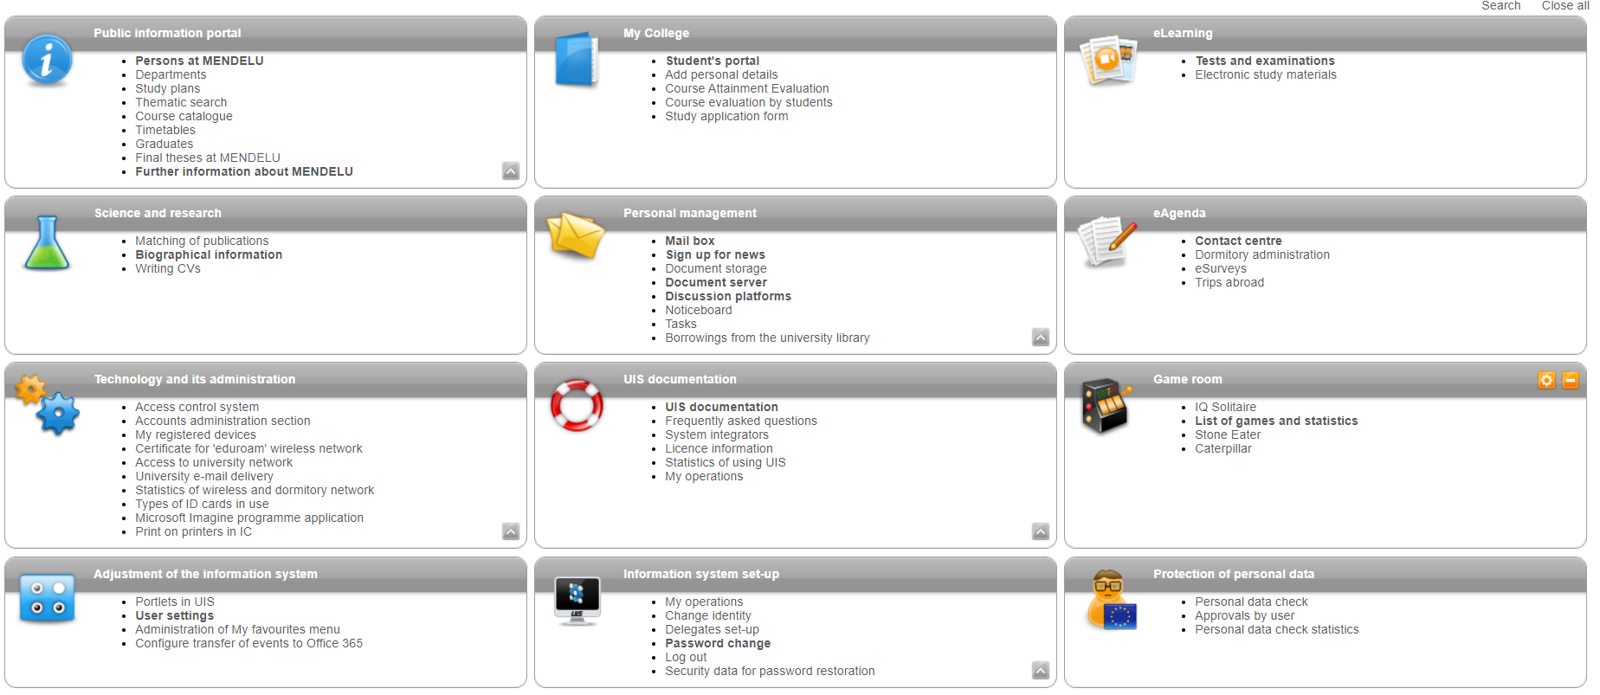
UIS

Slide 15
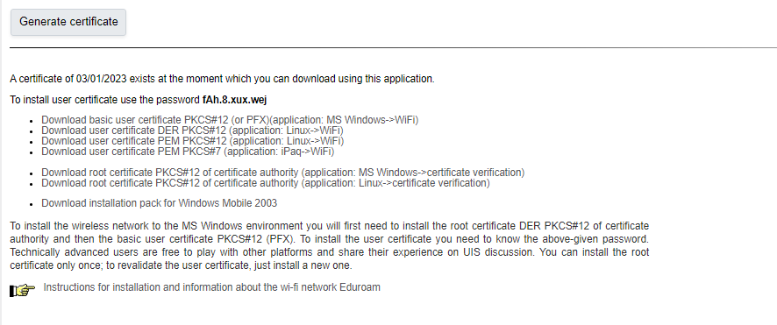
UIS - Eduroam

Slide 16
UIS – Student‘s Portal

Slide 17
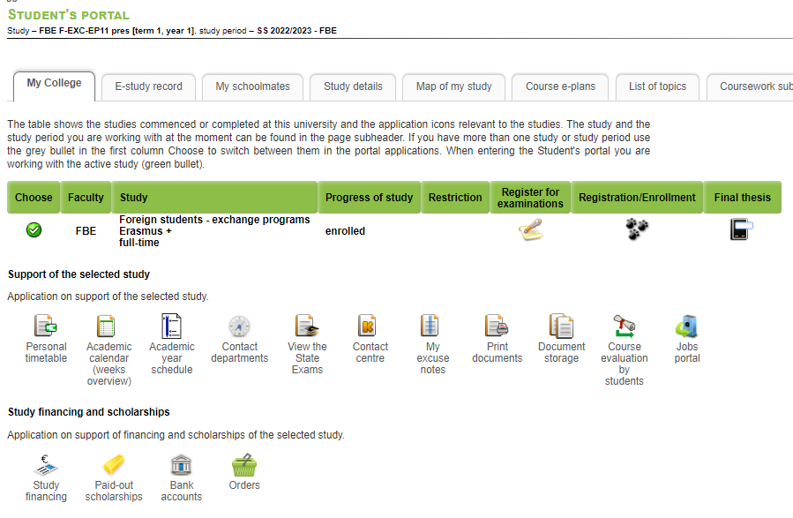
Study financing & Contact center

Slide 18
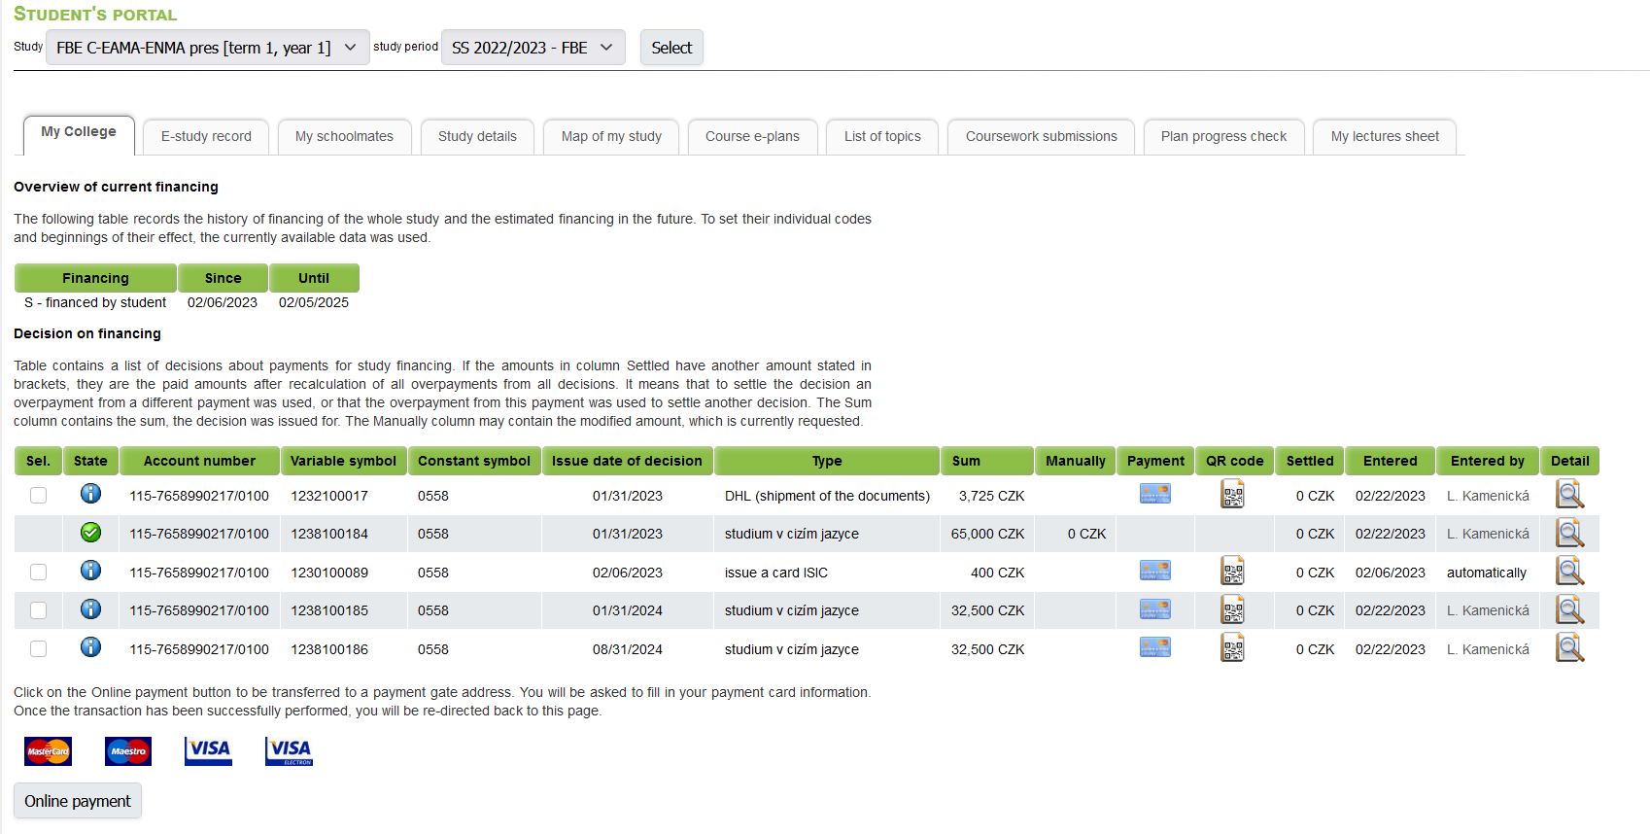
Study financing
Person responsible for payments is Mrs Lucie Kamenická, lucie.kamenicka@mendelu.cz
CLICK: https://pef.mendelu.cz/en/faculty-of-business-and-economics/student/tution-fees/
Notes:
The debts towards admission process (DHL, tuition fee for the first academic year, nostrification) need to be cleared before the next semester begins, otherwise the study department will not enroll you into the following semester. (payments cleared either before September or before February).
Studium v cizím jazyce – Tuition fee. You paid the first academic year. The following tuition fees can be paid by semesters.
State – status of your payment. If blue button with „i“ sign, it is NOT paid and you have to pay it. If green button with check mark, it is PAID and you cleared that payment
Issue date of decision – the deadline of the payment. (doesn‘t apply for the debts towards admission proces)
Sum – how much you need to pay
Manually – UIS doesn‘t have the best translation, we are sorry, but this means if you still have debts for the first year tuition fee, it will be mentioned in the section Manually. F.e. there was a bank transfer and the banks took some Exchange rate fees, etc.
https://pef.mendelu.cz/en/faculty-of-business-and-economics/student/tution-fees/

Slide 19
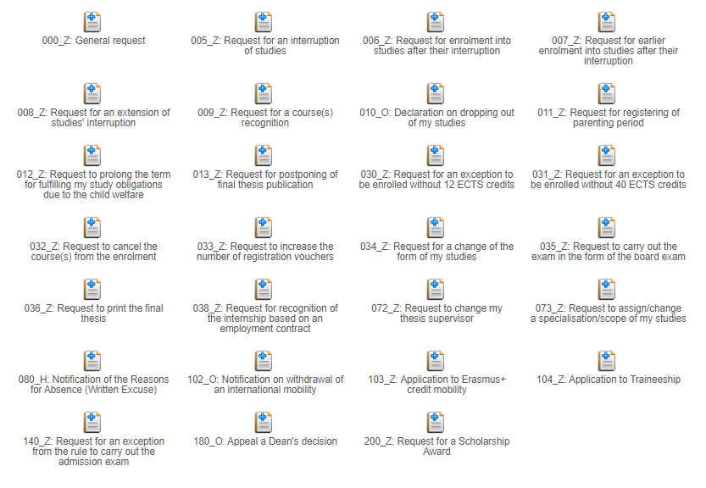
Contact center

Slide 20
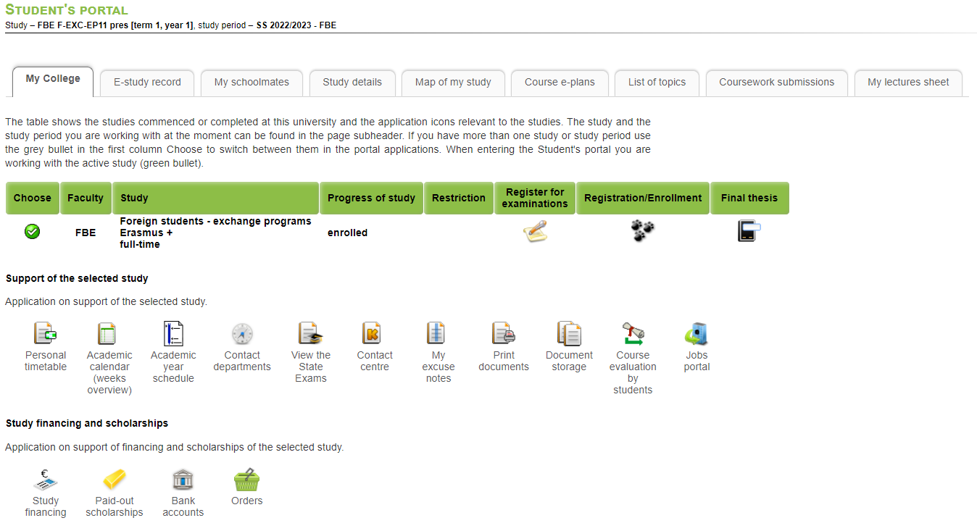
UIS - Student‘s Portal

Slide 21
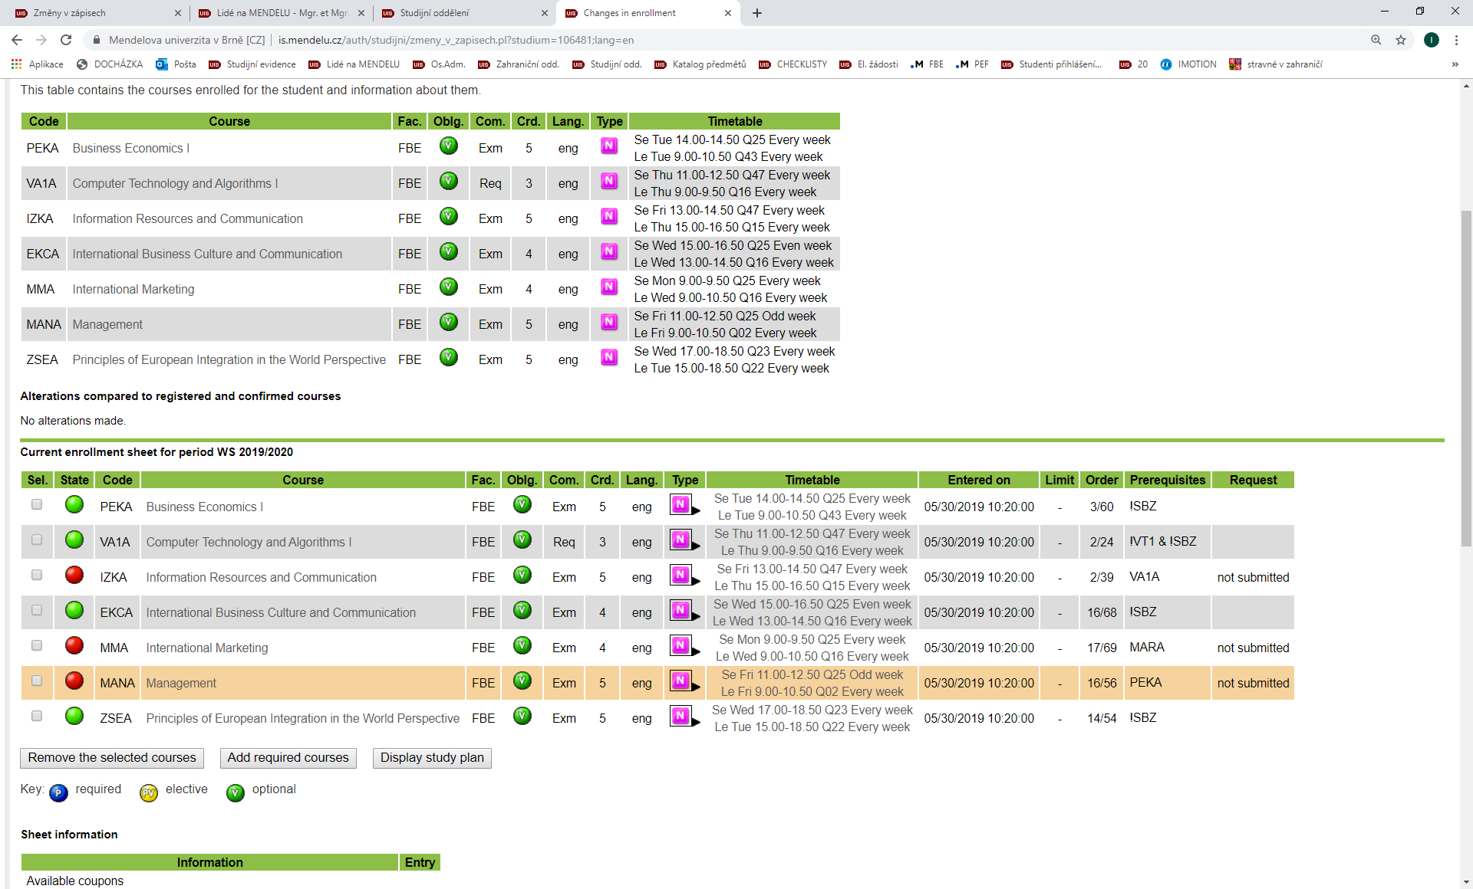
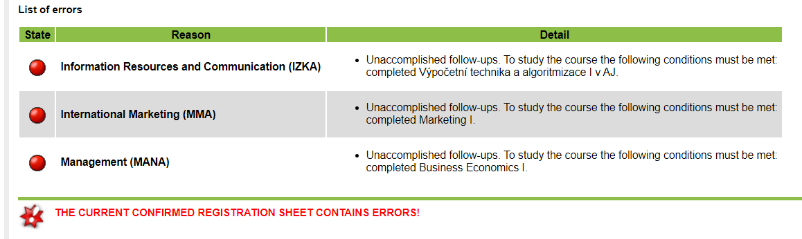
SAMPLE of student‘s enrollment
System of green/red dots
apply to subject follow-ups, to full capacity etc.
After the coures‘s registration, you must come to the Study Department for enrolment!
Notes:
First semester not, already done!

Slide 22
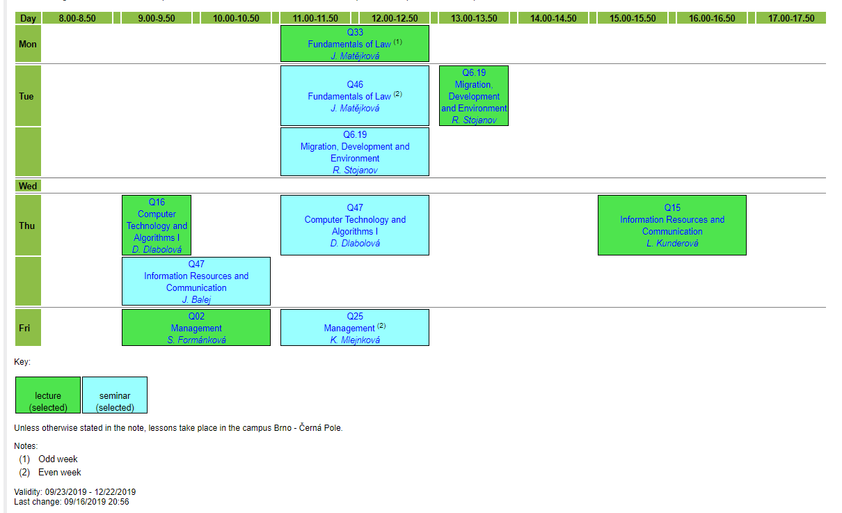
SAMPLE of student‘s timetable
lectures
seminars
Odd = 1,3,5…
Even = 2,4,6,…

Slide 23
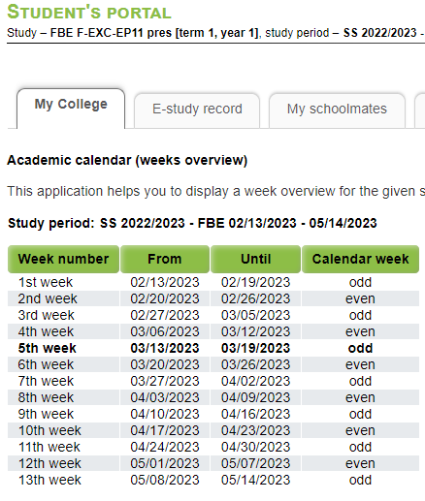
Timetables
What week is it?
Odd week: 1, 3, 5, 7,….
Even week: 2, 4, 6, 8,…

Slide 24
UIS – During semester

Slide 25
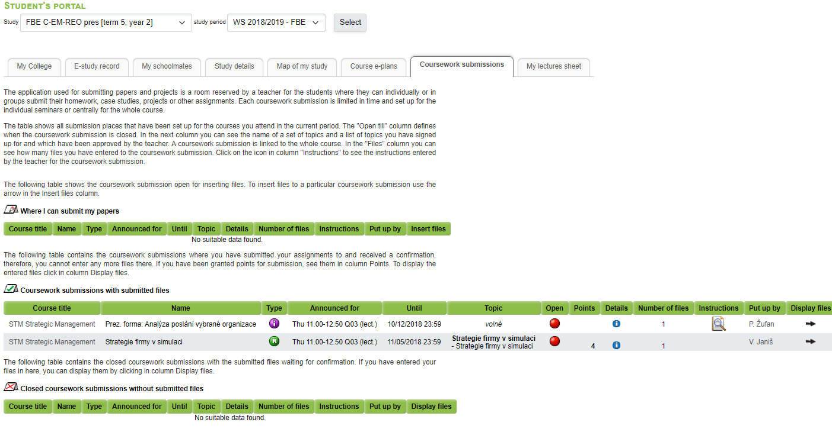
Coursework submission

Slide 26
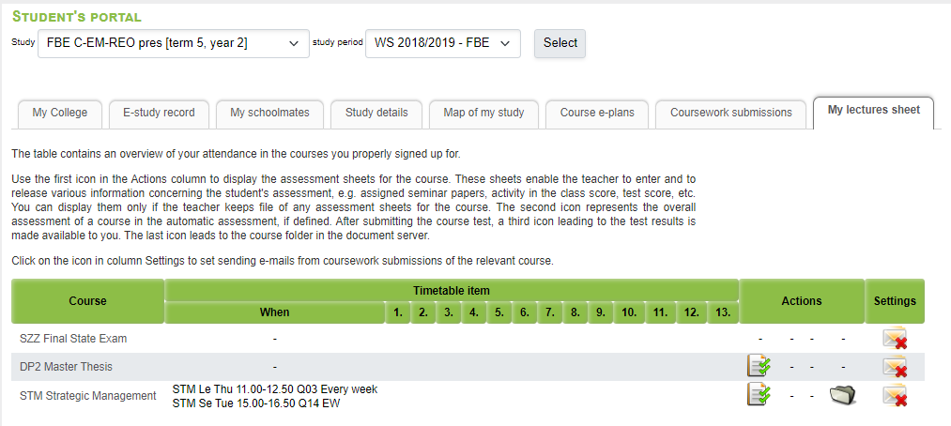
My lectures sheet
1
2

Slide 27
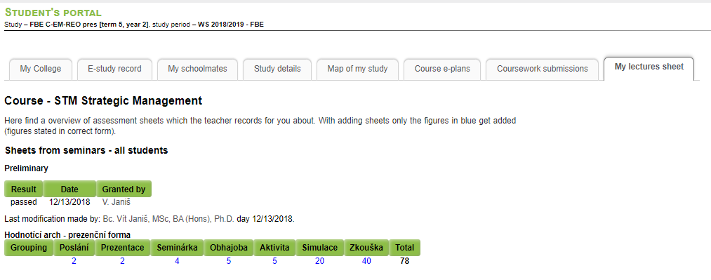
1
My lectures sheet

Slide 28
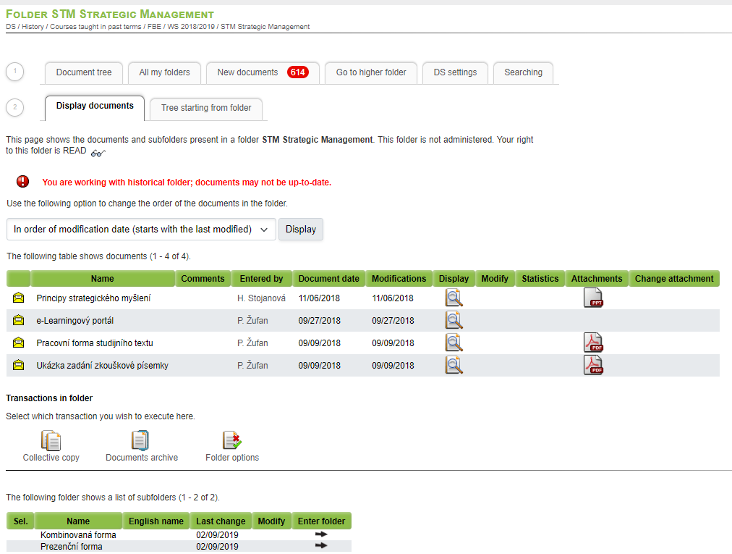
My lectures sheet
2

Slide 29
UIS – The end of semester

Slide 30
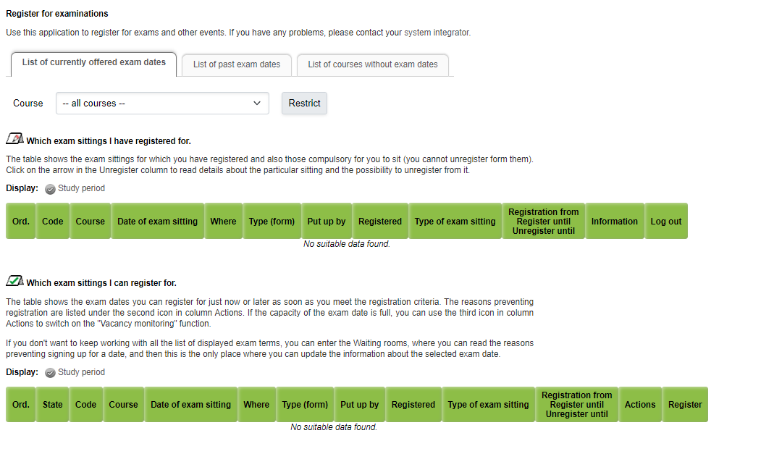
Registration for exams

Slide 31

Beware of plagiarism!!!
Please make sure to always cite your sources when writing a project, essay, homework.
Cheating on exams and plagiarism in writing is considered a serious break of study rules at MENDELU.

Slide 32
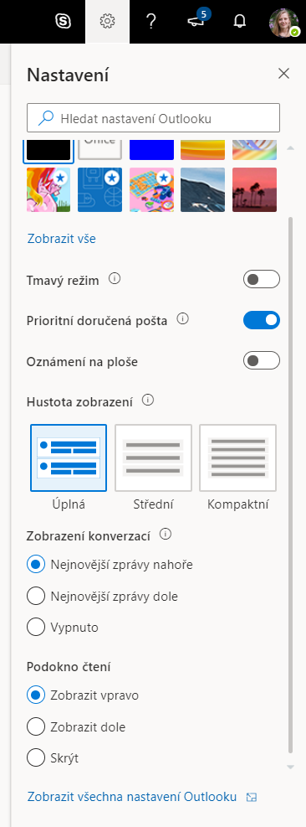
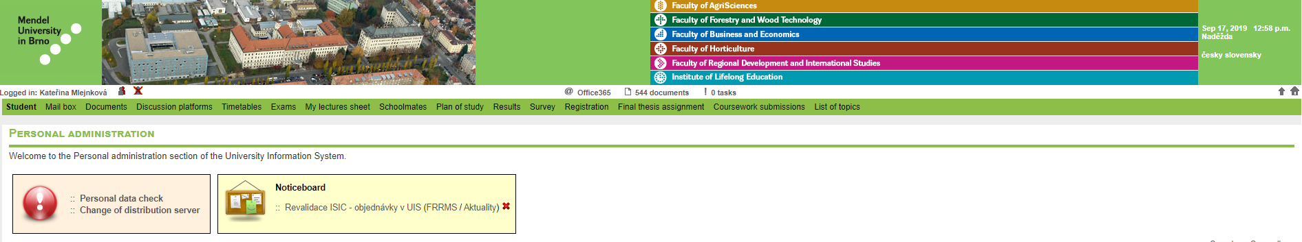
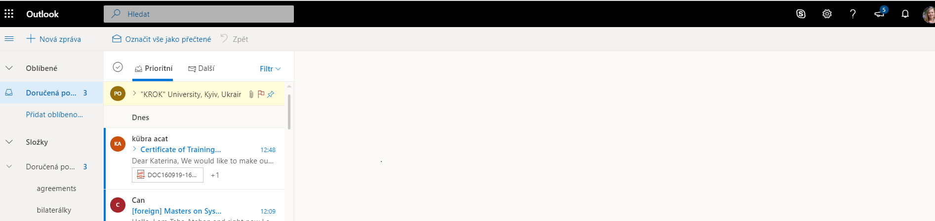
University e-mail – forwarding to personal e-mail
Video in english: https://www.youtube.com/watch?v=sDnk_8oXV_A
step 1
- enter e-mail folder
step 2
- click on Settings
step 3
- click to view all settings

Slide 33
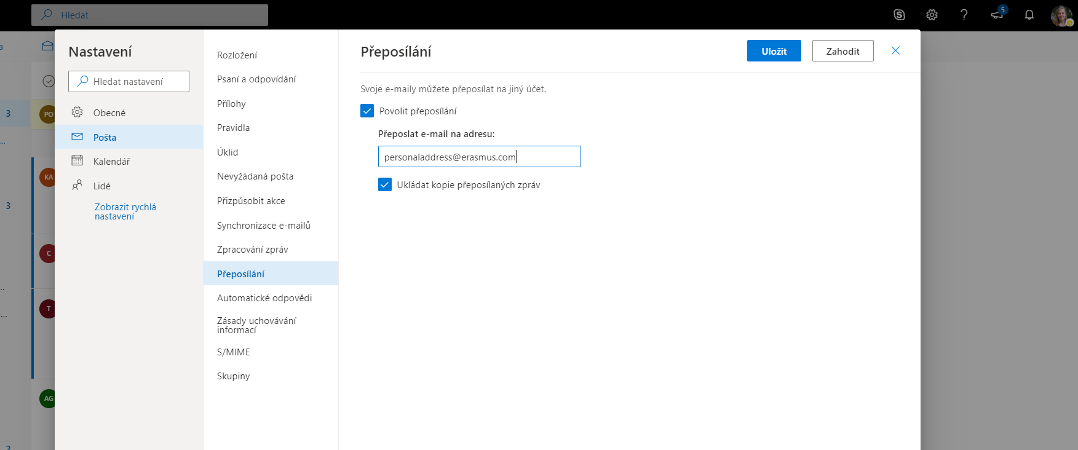
University e-mail – forwarding to personal e-mail
step 6
- save
step 5
- click and type your personal e-mail
step 4
- click on redirecting

Slide 34
Accommodation
Students are required to pay the fee for municipal waste disposal to Brno City Municipality
Please follow the instructions given in e-mails from dormitories or on displays at dormitories

Slide 35
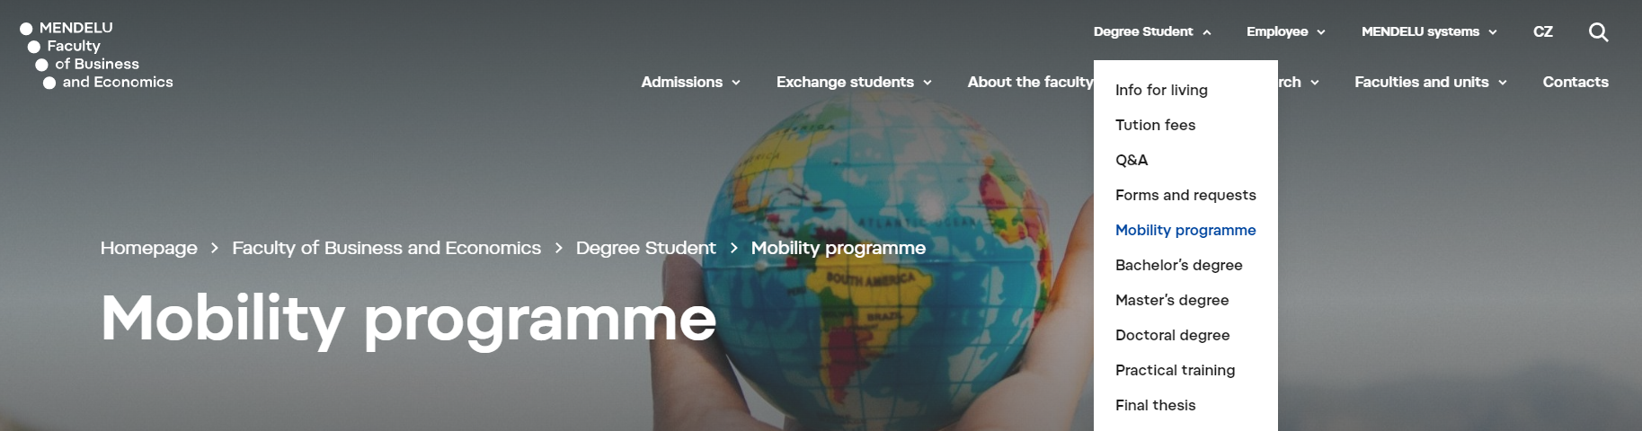
https://pef.mendelu.cz/en/faculty-of-business-and-economics/student/mobility-programmes/?psn=200
Exchange stays
Internships
Scholarship, Course recognition, Experience

Slide 36
Do you have any questions?
Contact:
Petra Katolická (Q 1.84)
petra.katolicka@mendelu.cz
Phone: +420 545 132 727

Slide 37
Thank you for your attention!

