Slide 1
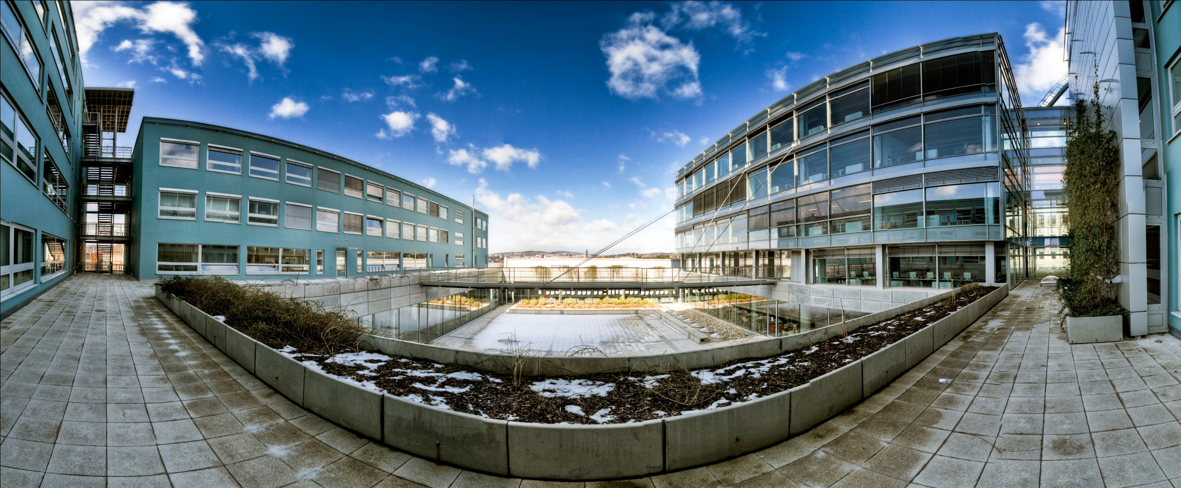
Faculty of Business and Economics
Mendel University in Brno
PR department, FBE MENDELU
Notes:
Socrates – which coutry?
Study in France
Presentation of Czech Republic
Thought would be easy
Don’t have any eiffel tower or stuff. But do the french looking forward to see their tower when they are abroad? It is small things that you miss after you leave country. It is atmosphere, people, food..

Slide 2
The Czech Republic is a landlocked country in Central Europe. The Czech Republic has been a member of NATO, the European Union and it belongs to Schengen area.
Notes:
Member:
NATO
EU from 2004 but still have CZK
Schengen of course

Slide 3
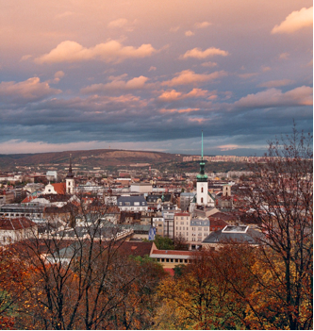
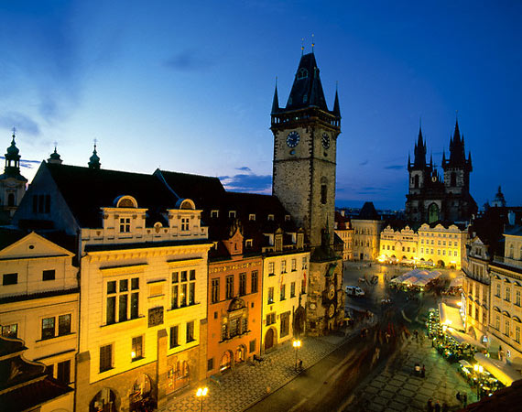
It has more than 10,3 million citizens.
^{The Czech Republic has} a temperate continental climate with hot summers and snowy winters
^{Capital Prague}
^{Currency CZK}

Slide 4
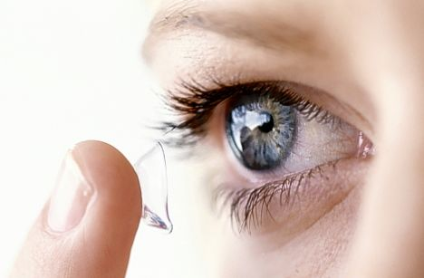
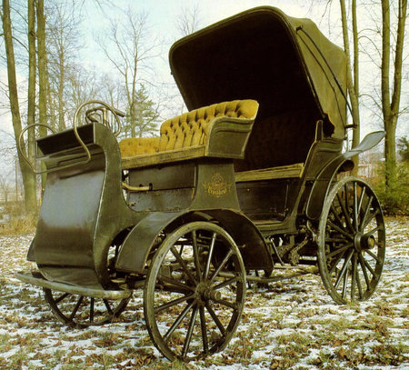
1961 contact lenses
1897 first car
Czech inventions
Notes:
Otto Wichterle – 1961
František Křižík - 1881

Slide 5
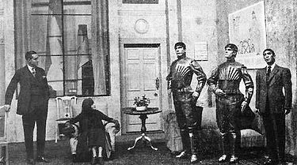
- SEMTEX
- ROBOT
- SUGAR CUBE
Czech inventions
Notes:
Auto - 1897-1898
V roce 1898 s ním Sviták ujel trasu z Kopřivnice do Vídně dlouhou 328 km. Trvala mu 14 a půl hodiny čisté jízdy.
Robot, semtex, sugar cube (1841)

Slide 6
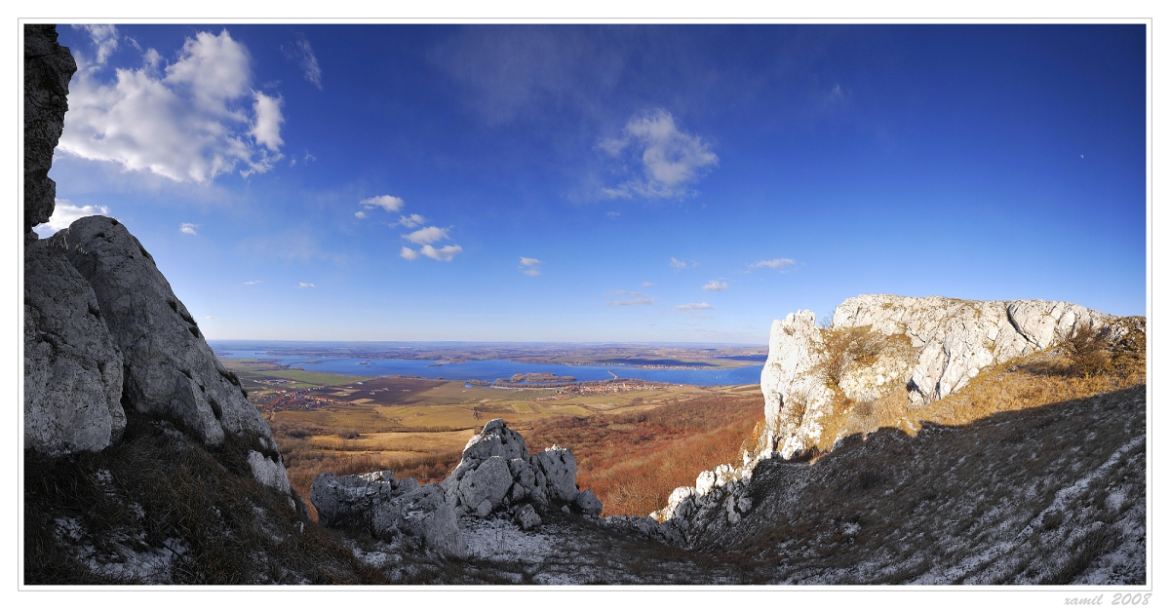
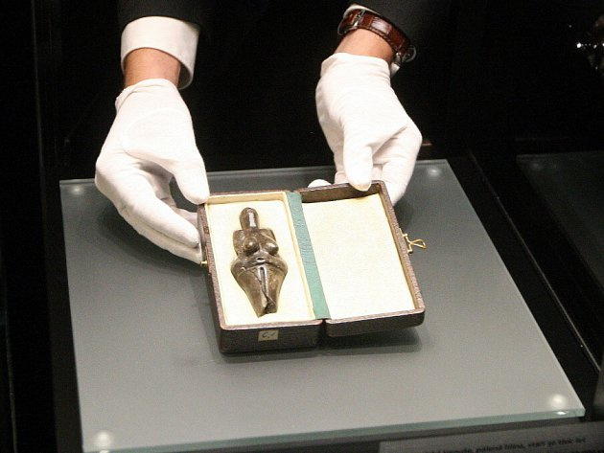
Moravia region
Notes:
Surroundings – Pálava, hills, castles,
Typical for Moravia – pálava, wine producers, beer also but Moravia mostly wine

Slide 7
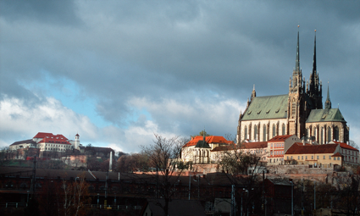
The region’s capital is the city of Brno
The largest Moravian city and the second largest city in the Czech Republic (it’s population is over 400.000 people).

Slide 8
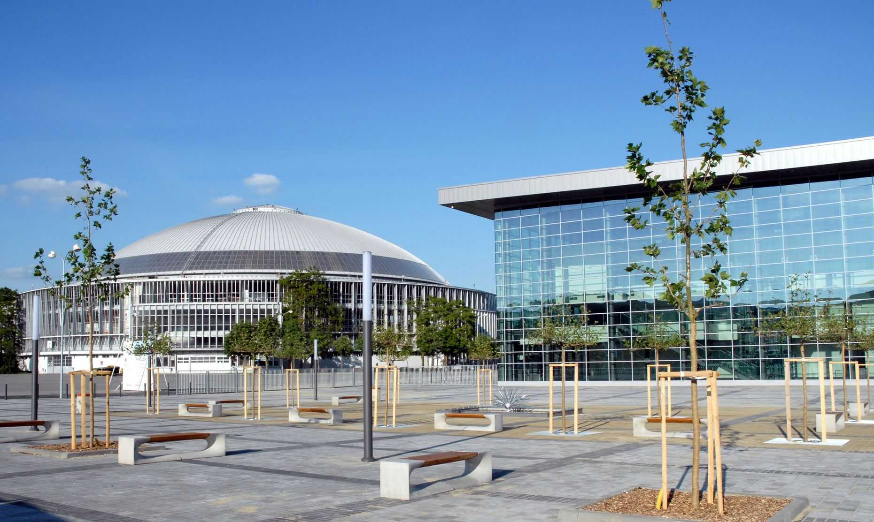
The Brno Exhibition Centre with its eighty-year tradition is a venue of many international trade fairs and exhibitions, and as such plays a significant role in the social and economic life of the city.

Slide 9
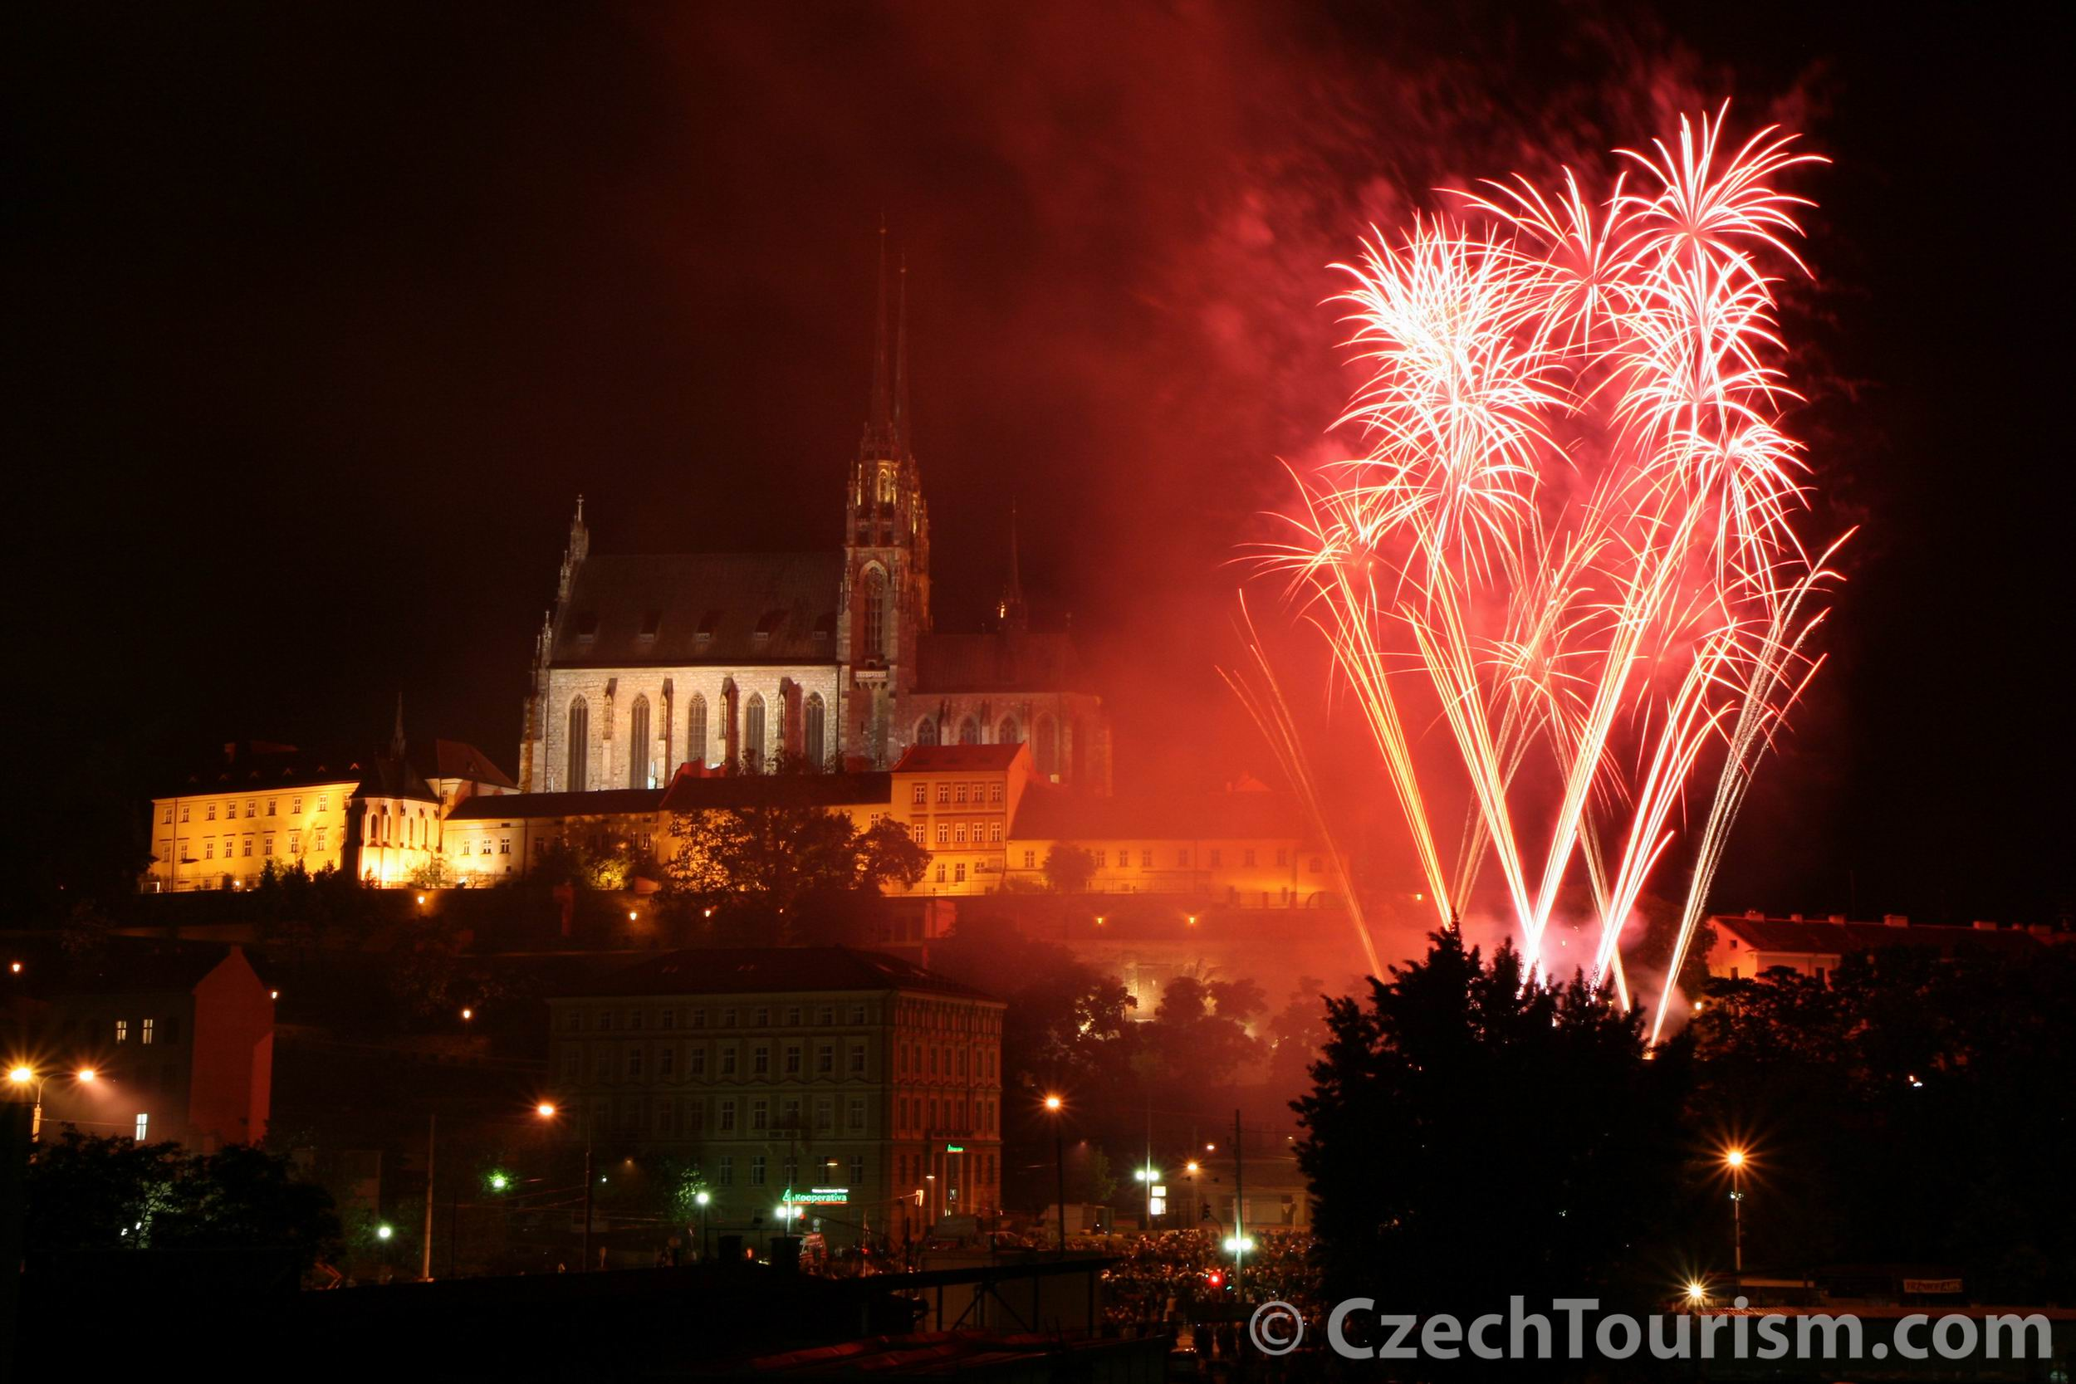
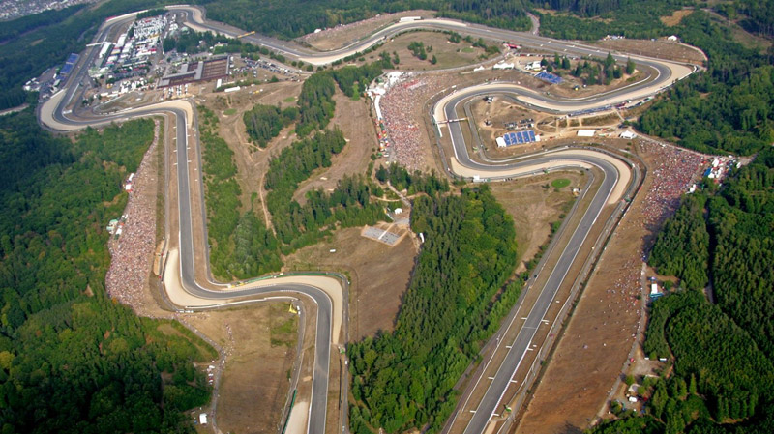
The City of Brno regularly hosts various cultural events (Ignis Brunensis), as well as some notable sporting events (Brno Grand Prix of road motorcycles).

Slide 10
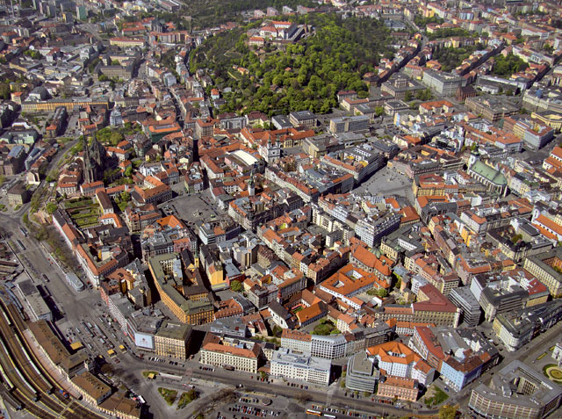
Brno is city of universities – it has 13 universities with 30 faculties and with over 90000 students. It is also a seat of important Czech judiciary institutions. It offers many possibilities of cultural enjoyment in its numerous theatres, museums, and coffee houses.
Notes:
Almost ¼ of all inhabitans of Brno

Slide 11
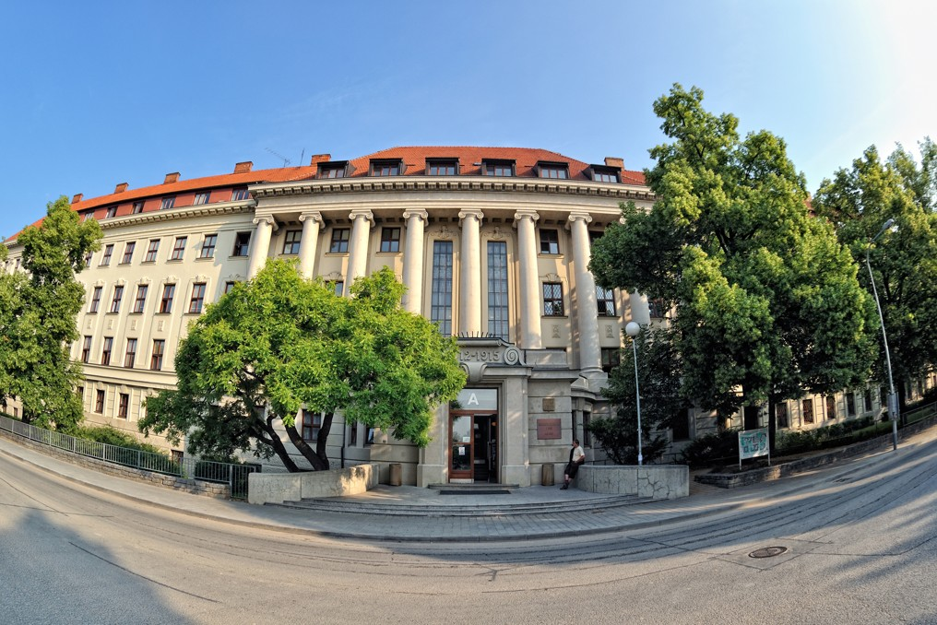
Mendel University in Brno

Slide 12
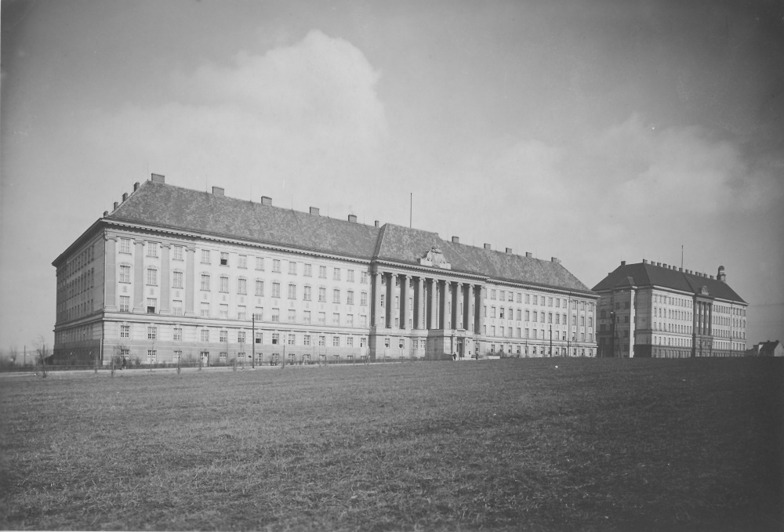
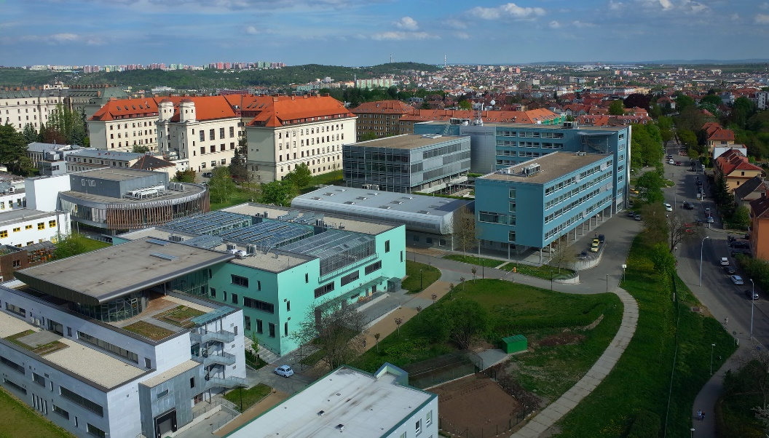
Mendel University in Brno was established in 1919 and presently has five faculties and one institute:
Faculty of Agronomy
Faculty of Forestry and Wood Technology
Faculty of Business and Economics
Faculty of Horticulture
Faculty of Regional Development and International Studies
Institute of Lifelong Learning

Slide 13
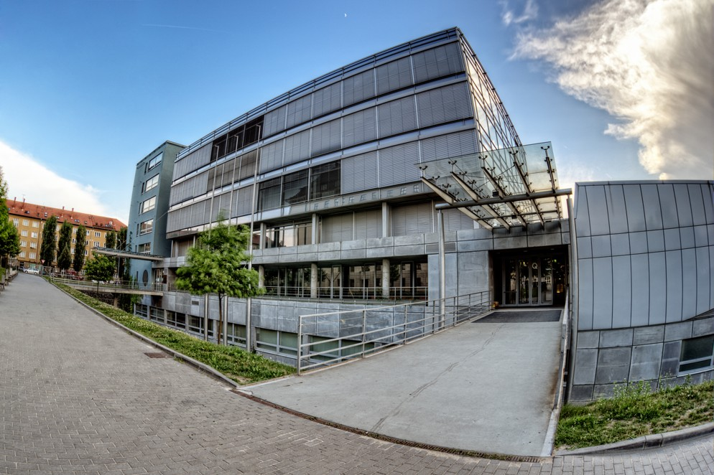
Faculty of Business and Economics of MENDELU

Slide 14
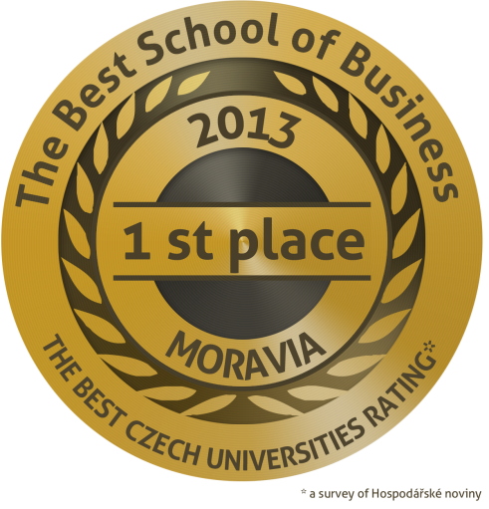
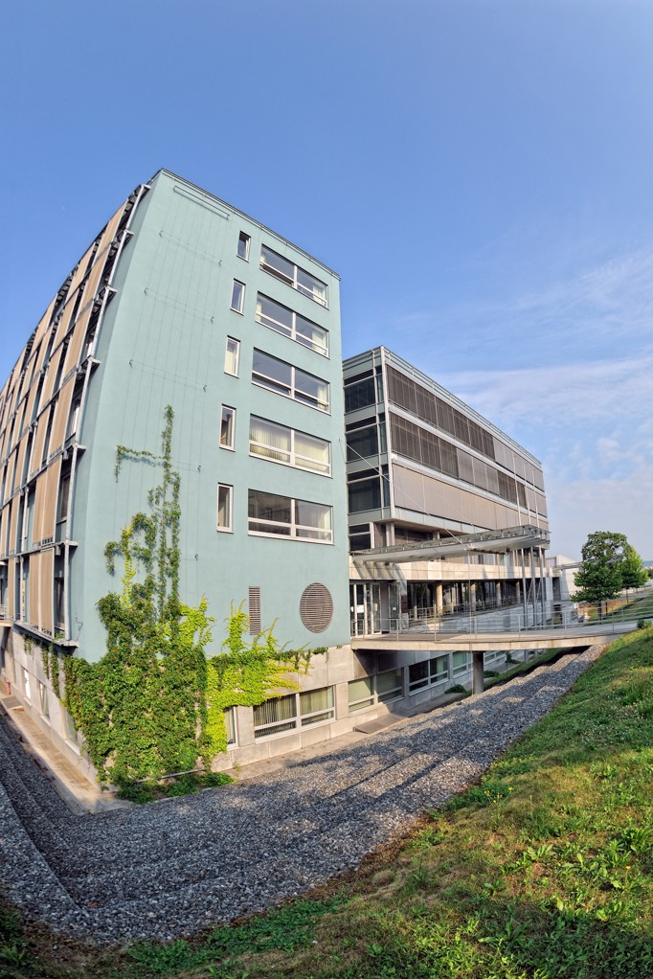
The oldest faculty of economics in Moravia (since 1959)
Providing all types of degrees (Bachelor, Master and Doctoral) in Czech and English
More than 10000 Master and 4500 Bachelor graduates
The best faculty of economics in Moravia and third university in Czech Republic (in 2010, 2011 and 2013)
Dean Assoc. Prof. Pavel Žufan, Ph.D.

Slide 15
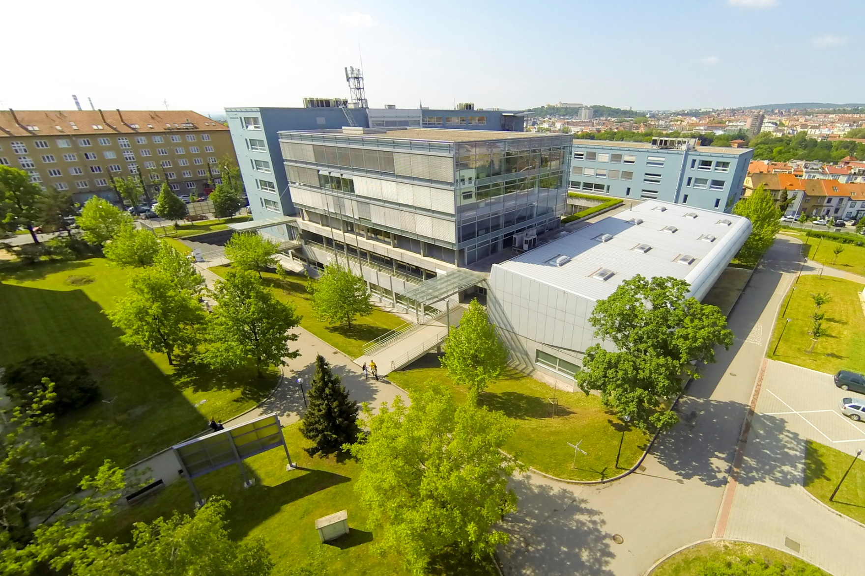
Professional academic background
Practical and flexible education (ECTS system)
High rate of school-leavers employment (almost 98% after 3 months after leaving school)
Bachelor programme ( 1574 students)
Master programme (791 students)
Doctoral programme (107 students)
+ 78 international students

Slide 16
Study Programmes
Bachelor, Master, Doctor
Economics and Management
Economic Policy and Administration
System Engineering and Informatics
Engineering Informatics

Slide 17
Prestigious partners
^{Main university partners}
Louisiana State University (USA)
^{Oregon State University (USA)}
^{Durham University (UK)}
University of Tasmania (Australia)
University College Cork (Ireland)
^{Kangwon National} ^{University (S.Korea)}
Shanghai University of Finance and Economics (China)
^{Main business partners}
^{IBM, Ltd}
^{Siemens, Ltd}
^{Honeywell, Ltd}
^{ExxonMobil, Ltd}
^{GE Money Bank, Inc.}
^{KPMG, Ltd}
^{Ernst & Young, Ltd}
^{Deloitte, Ltd}
^{PricewaterhouseCoopers}
^{... and many other partners}

Slide 18
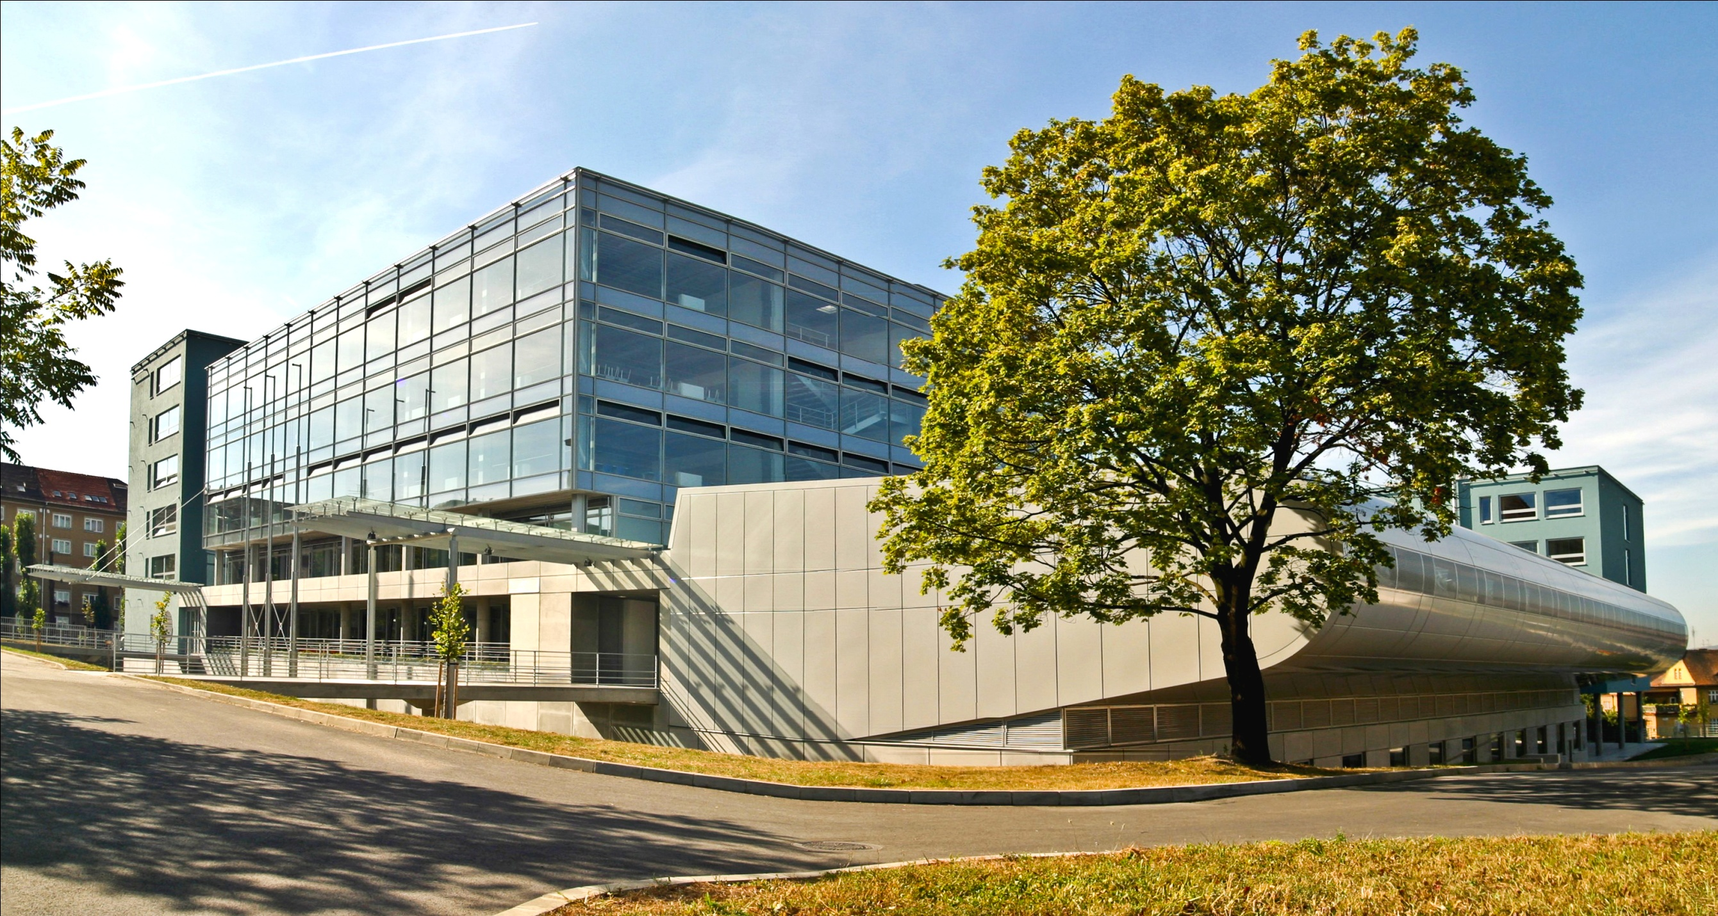
Thank you for attention Hana Urbankova Head of Public Relations of FBE

